Slide 1
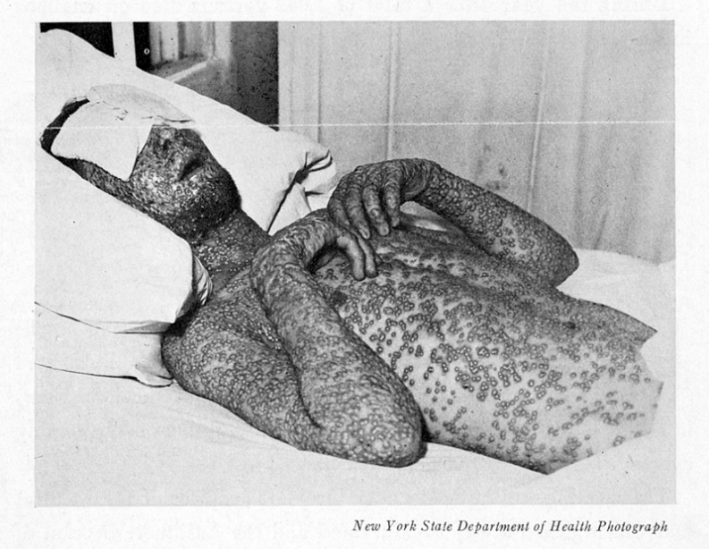
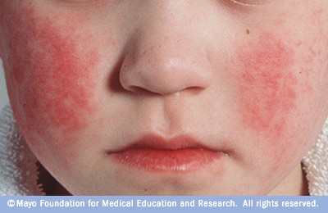
Lecture 8
DNA viruses
Pox, herpes, and beyond

Slide 2
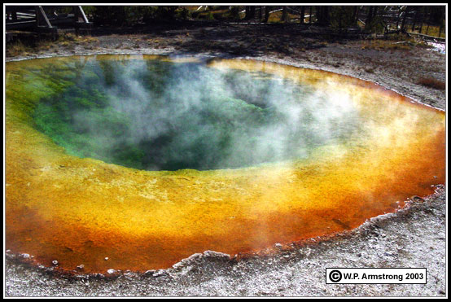
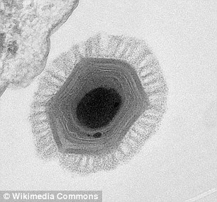
DNA viruses
Overview
• Viruses that have either a ssDNA or dsDNA genome and use
cellular DNA-dependent DNA polymerase to replicate their
genome
- Includes those in the Baltimore Group I and II
- Genome can be linear/circular, one piece/segmented
• Most replicate their genome in the nucleus of the host cell
• Includes many that are of great interest to us
- Vertebrate (human) viruses – Pox, Herpes, Papilloma,
Adeno, Polyoma, Parvo
- Largest viruses on Earth – Mimi, Mega, Pandora
- Nearly all Archae viruses

Slide 3
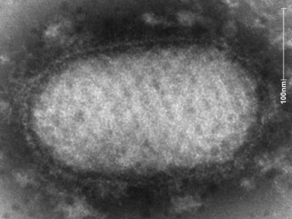
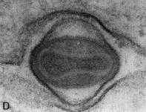
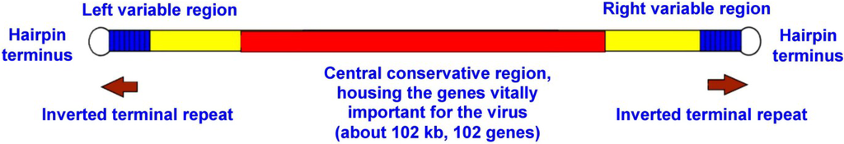
Vertebrate DNA viruses
Poxviruses
• Largest and most complex animal viruses
- Can be seen with a light microscope
• Unique structural characteristics
- Most have a brick or ovoid shaped nucleocapsid
- Linear dsDNA genome that contains 175-200 different
genes
- Two strands are connected covalently at each end to
create hairpins

Slide 4
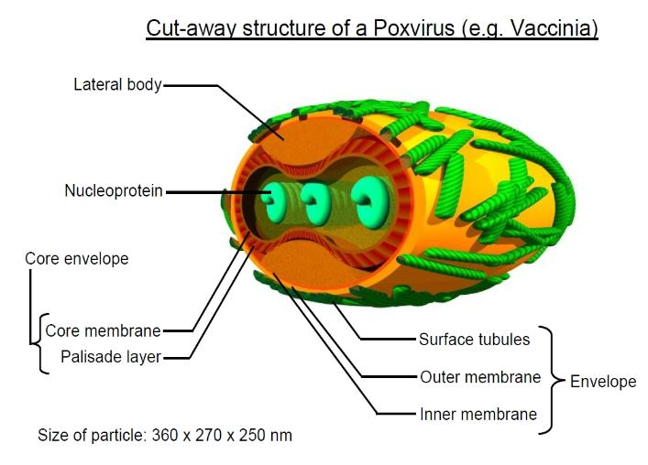
Vertebrate DNA viruses
Poxviruses
• Unique structural characteristics
- Multiple envelopes
- One outside of the core (NC)
and a one on the very outside
- Sometimes each are double
- Surface viral tubules rather than
typical glycoproteins
- Multiple layers of “matrix”, some of which has no known
function (lateral bodies)
- Contains a large number of replicative enzymes (e.g. pol)

Slide 5
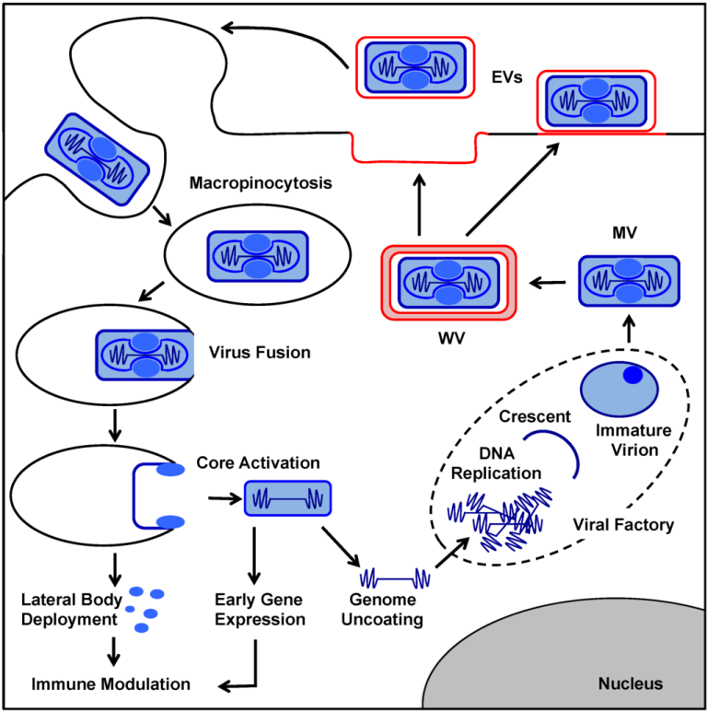
Vertebrate DNA viruses
Poxviruses
• Unique aspects of replication
- DNA virus that replicates completely within the cytosol
- Must bring in its own DNA
polymerase, primase, helicases,
topoisomerase, ligase,… for
DNA replication
- Must bring in its own RNA pol,
transcription factors, mRNA
capping enzymes, and mRNA
poly A polymerase to make and
process its mRNA (transcription)
- Replicates within special cytosolic
inclusion bodies in which new genomes pool together

Slide 6
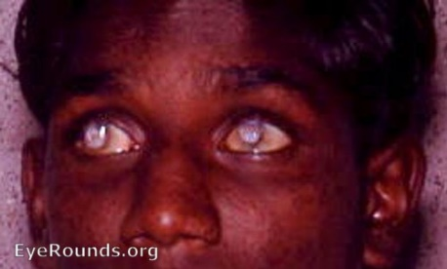
Vertebrate DNA viruses
Poxviruses
• Diseases affecting humans
- Smallpox is the only type that normally infected humans
- Monkeypox can also infect and kill humans (1-10%)
- Smallpox facts
- Caused by poxvirus variola
- 300-500 MILLION killed in 20th century alone, likely well
over a billion total
- Major plagues in Roman Empire, Americas, Africa
- Very high mortality rates – especially for children <5 yo
- Killed 95% of children in some locations
- Killed about 30% overall throughout history
- Survivors were left blinded (1/3) or scarred (3/4)
- Around from ancient times → 1980 (eradicated)

Slide 7
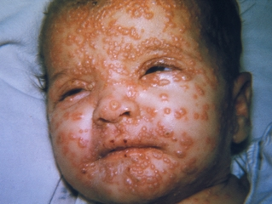
Vertebrate DNA viruses
Poxviruses
• Smallpox pathogenesis
- Spread between humans only – not from environment or
animals
- Respiratory secretions, contact with skin, contact with
anything that touched infected skin, mom→fetus
- Get internalized by local immune cells (macrophages) and
moved to lymph nodes → replicate there slowly at first
- Kill a bunch of cells at once, releasing virus into the blood
- Spread to rest of body, including skin and eyes
- Creates pustule rash, fever, muscle ache, fatigue
- Causes hemorrhaging, pneumonia, shock, and death by
day 16 post-infection

Slide 8
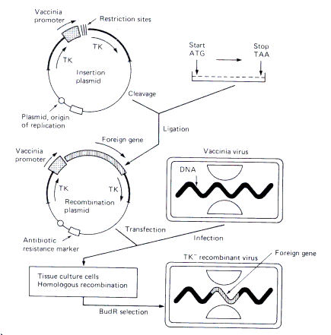
Vertebrate DNA viruses
Poxviruses
• Importance of other poxviruses
- Vaccinia virus
- Derivative of cowpox → used as our smallpox vaccine
- Cross-reactive immunity
- Commonly used to hold and
express foreign genes (viral vector)
- Cut and paste large foreign
genes into vaccinia genome
- E.g. Gene from HBV
- Put into infected cells → purify
vaccinia virions carrying gene
- Can now use recombo. vaccinia
to infect a person (delivering the
foreign gene) or animal

Slide 9
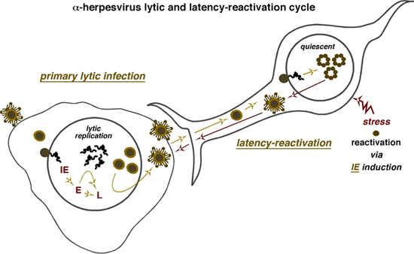
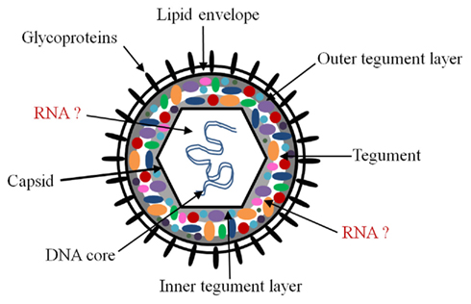
Vertebrate DNA viruses
Herpesviruses
• Large, enveloped dsDNA viruses
- Contains a diverse matrix layer called
the tegument
- Has many glycoproteins that enable it
to infect a variety of tissues
• Defined by their ability to establish a true latent infection
- After primary infection, some capsids take genome
and bring it into either a neuron (alpha), leukocyte (beta),
or B/T cells (gammaherpesviruses)
- In that other cell, virus is metabolically dormant (latent)
- Will stay there for life of the infected

Slide 10
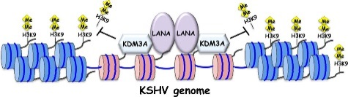
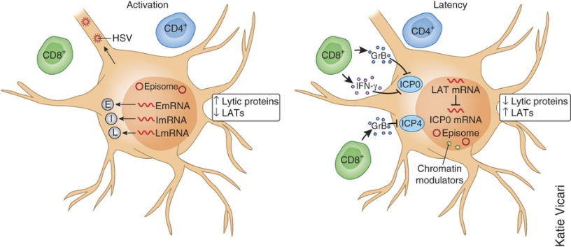
Vertebrate DNA viruses
Herpesviruses
• How do herpesviruses go latent?
- Latent herpesviruses express a
gene that leads to the accumulation
of an RNA called LAT (latency associated transcript)
- LAT RNAs shut down viral replication
- Inhibits expression of other herpes genes directly
- Recruits cellular histones → bind and block herpes DNA
as heterochromatin
- Enable immune suppression of viral replication
- Block the cells from killing themselves
- Herpes genome remains inactive in the nucleus

Slide 11


Vertebrate DNA viruses
Herpesviruses
• How do herpesviruses reactivate?
- Usually reactivate following some stress to the organism
- UV light (sunburn), emotional stress, extreme physical
stress, hormonal spikes
- Can continually reactivate for the life of the individual
- Reactivates, replicates, cause disease, go back latent
- Frequency of reactivation directly proportional to inoculum
level of initial infection
- Requires certain viral proteins to “wake up” the genome
- ICP0 and VP16 thought to be very important

Slide 12
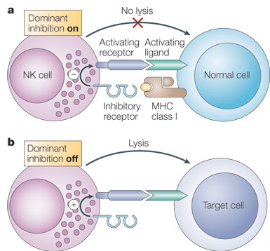

Vertebrate DNA viruses
Herpesviruses
• Other unique aspects to its replication
- Express their genes in waves
- All typically have three classes of genes
- Immediate-early (IE) – right after entry, set up infection
- Early (E) – DNA replication, modulate cell metabolism
- Late (L) – structural proteins to be packaged into virions
- Engage in many forms of immune evasion
- Disrupt cellular MHC expression → antigen presentation
- Make fake (homologs) cytokines and receptors →
communication
- Prevent NK cell recognition → killing

Slide 13
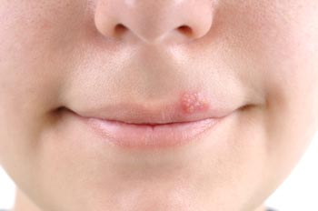
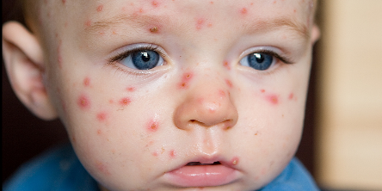
Vertebrate DNA viruses
Herpesviruses
• Types of human herpesviruses and their diseases
- Alphaherpesviruses
- Herpes simplex virus (type 1 or 2) – aka HHV-1, HHV-2
- Largely causes painful watery blisters on the mucosa
of the mouth (1) or genitals (2)
- Spread through any contact between mucous mems.
- Can spread beyond in immunocompromised
- Herpes keratitis (eye), encephalitis (CNS), all over skin
- Varicella zoster virus (VZV) – aka HHV-3
- Causes chickenpox in primary infection and a very
painful shingles (herpes zoster) when reactivated
- Can spread & cause pneumonia, encephalitis, neuralgia

Slide 14
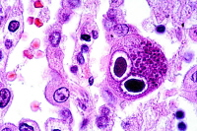
Vertebrate DNA viruses
Herpesviruses
• Types of human herpesviruses and their diseases
- Betaherpesviruses
- Human cytomegalovirus (HCMV) – aka HHV-5
- Nearly ubiquitous in the population (60-100%)
- Infects almost every tissue in the body
- Usually produces asymptomatic disease
- Immunocompromised are extremely at risk
- Congenital/neonatal – if mom gets 1° or reactivation
while pregnant (can cross the placenta)
- Deafness, encephalitis, intellectual disabilities
- HIV – get systemic CMV infections (death can follow)
- Organ transplants – put on immunosuppressive drugs
- Cancer – chemotherapy weakens immune system

Slide 15
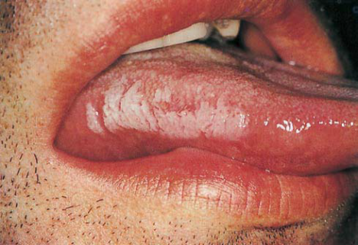

Vertebrate DNA viruses
Herpesviruses
• Types of human herpesviruses and their diseases
- Gammaherpesviruses
- Epstein-Barr virus (EBV) – aka HHV-4
- Ubiquitous (90% adults)
- Infects epithelial cells and spreads to B cells
- Latency occurs there
- Cause of infectious mononucleosis (mono), many forms
of lymphoma (Burkitt’s, Hodgkin’s), gastric cancer,
and hairy leukoplakia (in HIV patients)
- Mono can occur when 1st infected as older kid/teen
- May also cause chronic fatigue syndrome and trigger
some forms of autoimmunity (SLE, RA, MS)
- Links not completely confirmed

Slide 16
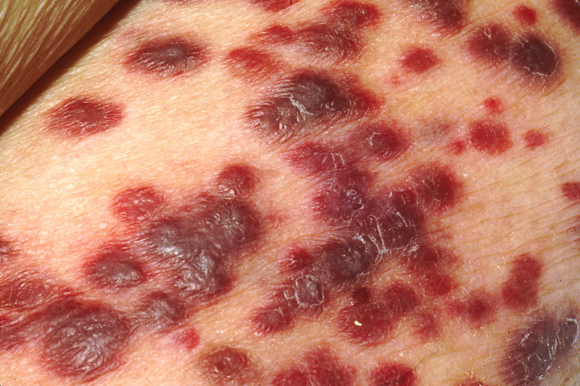
Vertebrate DNA viruses
Herpesviruses
• Types of human herpesviruses and their diseases
- Gammaherpesviruses
- Kaposi-sarcoma herpesvirus (KSHV) – aka HHV-8
- Causes KS - a skin cancer seen in HIV/AIDS cases
- Very recently discovered
and hotly contested
- Common in Africa and
Mediterranean countries
- Unknown mechanism of
transmission (STD, ?)
- Most people harbor it
asymptomatically
- Immunosuppression allows for replication

Slide 17
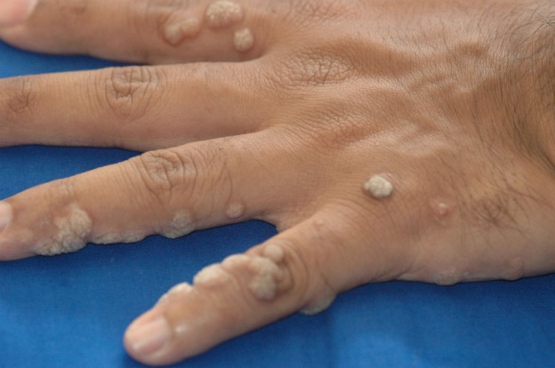
Vertebrate DNA viruses
Papillomaviruses
• Small, non-enveloped DNA viruses that primarily infect
stratified epithelial tissue of the skin and mucous
membranes
• All >200 types of human papillomaviruses (HPVs) produce
excessive tissue growth
- Can produce benign warts (hand, plantar, genital)
- Some types cause cancerous lesions (cervical, anal, oral)
- About 5% of ALL human cancers caused by HPV
• HPV cancers can be prevented with a
vaccine → Gardasil
- Contains proteins from most important
cancer-causing types (6,11,16 & 18)

Slide 18
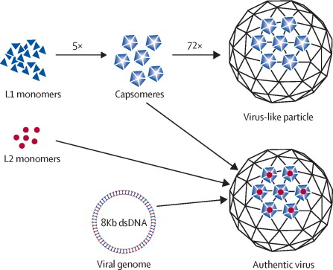
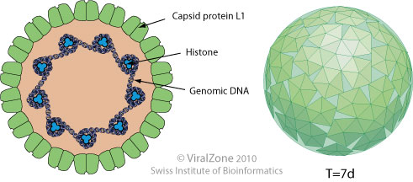
Vertebrate DNA viruses
Papillomaviruses
• Unique structural features
- Icosahedral capsids that contain a major capsid protein L1
(forms pentameric capsomeres) and minor protein L2
- Single, circular dsDNA genome that is bound by cellular
histones
- Keeps genome organized like cellular chromatin

Slide 19

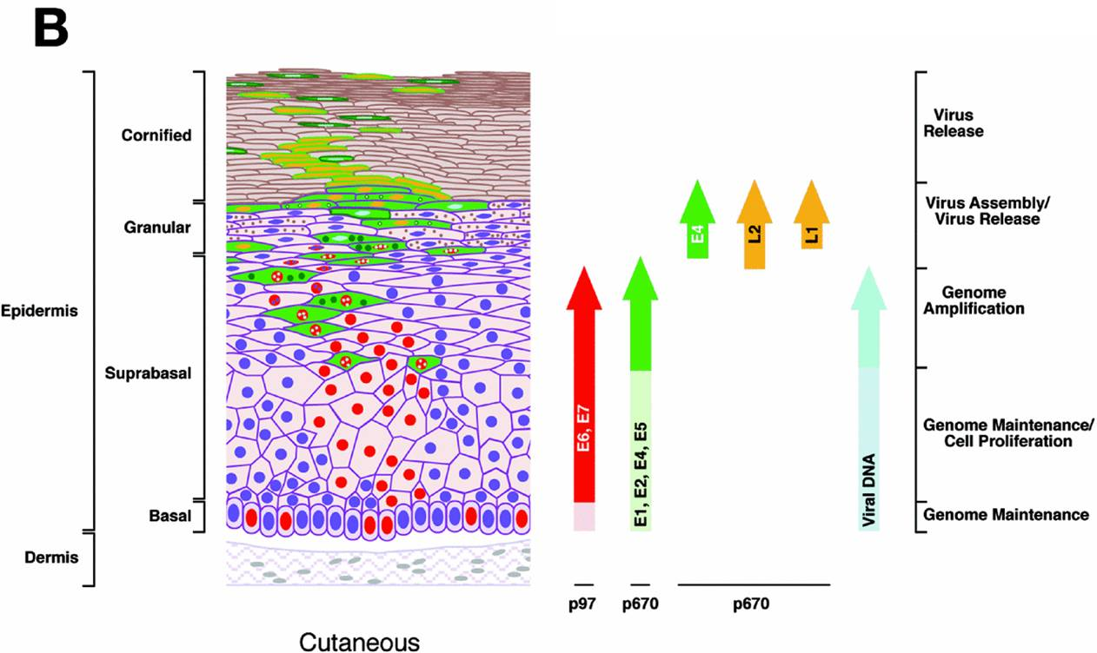
Vertebrate DNA viruses
Papillomaviruses
• Unique aspects of its replication
- Must gain entry into the basal layer of skin through a wound
- Why HPVs commonly infect hands and feet?
- Completes its replication cycle only as the virions move w/in
cells through all the skin strata
- Will turn on certain genes
in certain layers of tissue
- Virions get sloughed
off w/ dried squams
- Genomes stay in basal
layer unless destroyed
(laser or extreme cold)
- Can “reactivate” years after initial infection

Slide 20
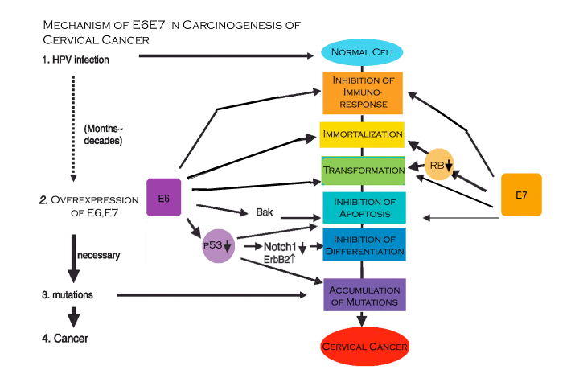
Vertebrate DNA viruses
Papillomaviruses
• How does it cause cancer?
- Ability to induce cancerous growth is due to expression of
four important genes that alter cell division, DNA repair, and
cell death
- HPV E6 and E7 oncoproteins
- E6 binds to and inhibits the
cellular p53 protein
- p53 monitors the genome
for damage and induces
cell death if too damaged
- No p53 → tons of mutations,
no apoptosis, excessive
cell division

Slide 21
Vertebrate DNA viruses
Papillomaviruses
• How does it cause cancer?
- HPV E6 and E7 oncoproteins
- E7 binds to and inhibits the cellular Rb protein
- RB prevents cells from moving forward in the cell cycle
by blocking a transcription
factor called E2F
- No Rb → E2F activates
cyclins/CDKs → non-stop
movement through the cell
cycle
- E6/E7 don’t directly cause cancer
- Inhibit normal cellular protections → cells mutate/divide

Slide 22
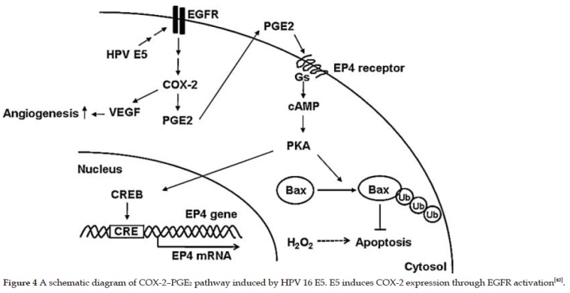
Vertebrate DNA viruses
Papillomaviruses
• How does it cause cancer?
- HPV E2
- E2 normally functions to inhibit E6/E7 expression
- Non-cancerous types express high levels of E2
- Most dangerous types (16 and 18) have little to no E2
- HPV E5
- Binds to cellular EGF receptor
and activates its signaling activity
- Result is an inhibition of apoptosis
and increase in cell division
- The HPV genome usually integrates into the host genome
in types that cause cancer

Slide 23
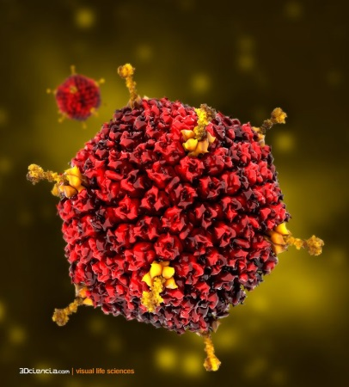

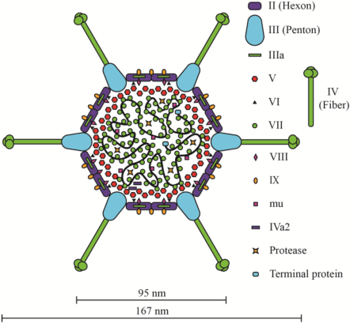
Vertebrate DNA viruses
Adenoviruses
• Large group of complex, non-enveloped
icosahedral viruses w/ dsDNA genome
- Have fiber proteins projecting from each vertex
• Human infections are usually asymptomatic, but can present
with cold or mild flu-like symptoms
- First isolated from adenoids
- In immunocompromised (HIV, young kids),
can cause tonsillitis, conjunctivitis,
pneumonia, and even death
• Those recovered continue to shed virus
- Like HPV, establishes a persistent infection

Slide 24
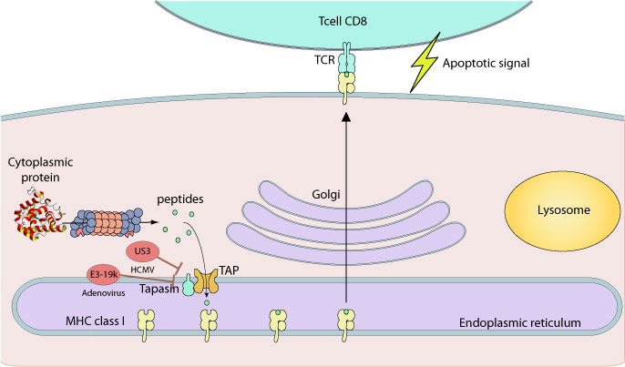
Vertebrate DNA viruses
Adenoviruses
• Special features of its structure and replication
- Unusually stable capsids help make them resistant to
chemical agents (e.g. weak chlorine) and pH extremes
- Has an amazing ability to evade host immune response
- Blocks interferon response, blocks class I MHC
expression, prevents apoptosis
- Makes two proteins (E1A and E1B) that
can transform normal cells into tumors
- E1A blocks Rb, E1B blocks p53
- Only works in vitro (no human cancers reported)
- Replicates differently in layers of stratified epith (like HPV)

Slide 25
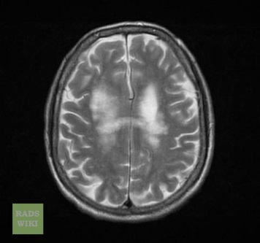
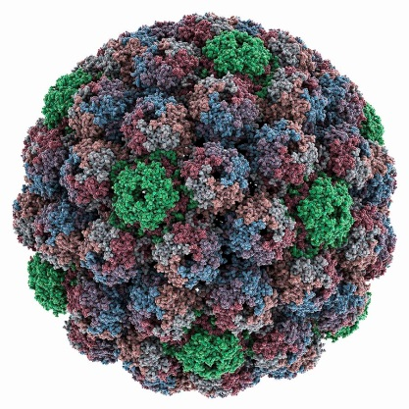
Vertebrate DNA viruses
Polyomaviruses
• Small, nonenveloped icosahedral viruses
- dsDNA genomes are only about 5,000 nucleotides and
only code for a handful of proteins
- Capsid proteins don’t form normal hexon or penton
capsomeres
• Only three types are believed to cause human disease
- JC virus – causes PML or progressive multifocal
leukoencephalopathy (slow destruction of brain white matter)
- Usually only problem in AIDS or organ transplant patients
- Kill 30-50% and debilitate rest
- Symptoms depend on part of brain – clumsiness, speech
changes, personality changes, alien hand syndrome

Slide 26
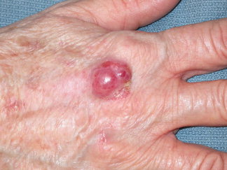
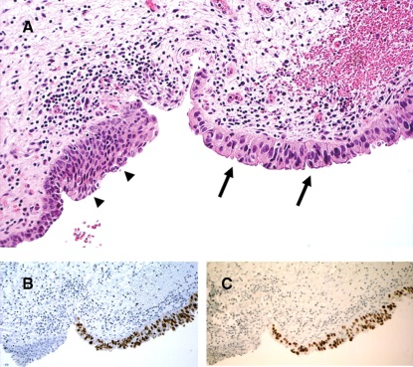
Vertebrate DNA viruses
Polyomaviruses
• Only three types are believed to cause human disease
- BK virus – causes respiratory illness and kidney failure in
immunocompromised individuals
- Virus remains persistent in kidneys and urinary tract of
most of the population
- Major problem in kidney transplant patients – can lead to
nephropathy and loss of graft
- Merkel cell virus – causes Merkel cell carcinoma
- Aggressive and rare form of skin cancer that affects the
cells controlling touch and pressure sensation
- Like HPV, integrates into the host genome during process
of cancer formation

Slide 27
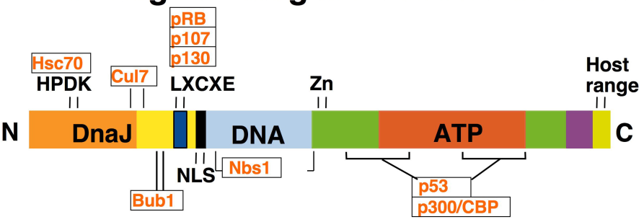
Vertebrate DNA viruses
Polyomaviruses
• Special features of its replication and pathogenesis
- Nearly all polyomaviruses have the ability to transform
normal cells into tumor cells in cell culture
- Some do so as well in animals, but most don’t
- Ability to trigger abnormal cellular growth mostly due to
expression of a powerful protein named large T antigen
- TAg inhibits both p53 and Rb and activates important
transcription factors
- TAg also triggers replication
of the viral genome, inhibits
apoptosis, regulates viral
gene expression and assembly

Slide 28
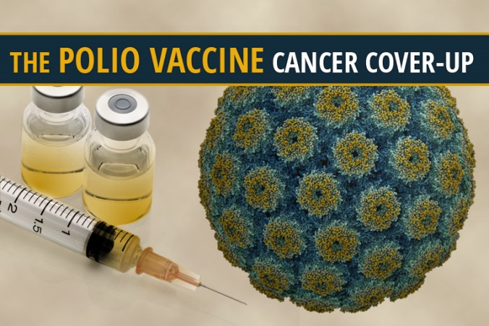
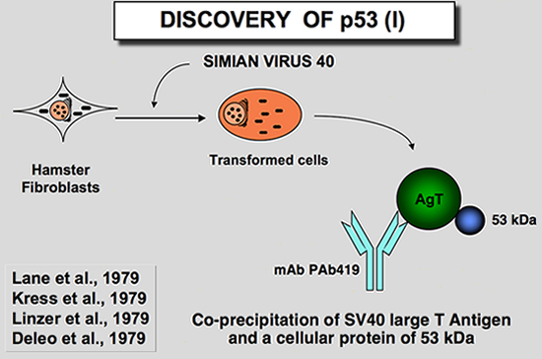
Vertebrate DNA viruses
Polyomaviruses
• SV40, polio vaccine, tumor suppressors, and fear
- Polio vaccine was created in an African Green monkey cell
line that grew well in lab
- Didn’t know that they grew well b/c
they were infected with SV40, a
polyomavirus
- About 400,000 kids were given
Salk vaccine contaminated w/ SV40
- Makes TAg → Cancer???
- SV40 TAg found to bind strongly to
a cellular 53 kDa protein
- Turned out to be p53
- Opened up field of oncogenes/TS

Slide 29


Vertebrate DNA viruses
Parvoviruses
• Single-stranded DNA viruses that have extremely small, naked
icosahedral capsids (parvus = small)
- Genomes are ~5,000 nucleotides (like polyoma), but must
fit into much smaller capsids
- Does so b/c its ssDNA
- Has very stable capsids - resistant to hot temps, pH
changes, solvents
• Causes gastrointestinal issues, immunosuppression, and
inflammation in many types of animals (dogs, cats)
- Depending on age, can also infect the heart or cause
hemorrahaging
- Untreated → ~ 90% fatality in most cases

Slide 30
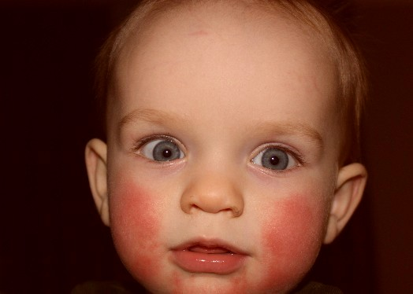
Vertebrate DNA viruses
Parvoviruses
• Humans can also be infected by parvoviruses
- Fifth disease (Parvovirus B19)
- Mainly seen in kids
- Presents as a rash (esp on the
cheeks) and fever in kids
- Adults can have severe arthritis
or miscarriage (pregnant)
- Was one of the 5 classical rash
diseases in childhood (5th one)
• Parvoviruses are different from other small DNA viruses
- Only can replicate in actively dividing cells
- Can’t force the cell to replicate its genome
- No risk of tumor formation

Slide 31
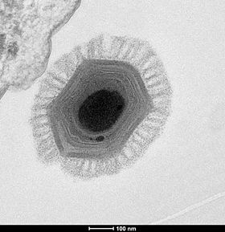
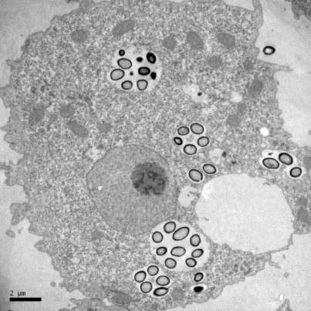
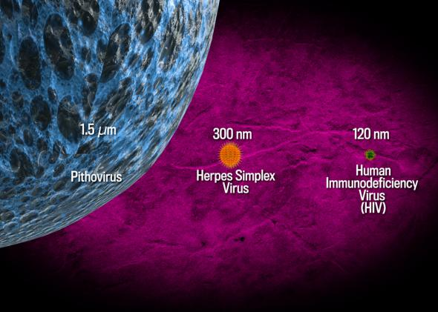
Largest DNA viruses
Beginning of life?
• Largest viruses ever discovered are pathogens of amoeba
- Includes Mimivirus, Pithovirus, Megavirus,
and Pandoravirus (the biggest genome)
- Can be seen with a light microscope and
can be Gram stained
- Can code for several thousand proteins
• Genomes contain genes normally only
found in cells
- Enzymes that load aa onto tRNAs
- DNA polymerases
- Many involved in lipid, amino acid, and
sugar metabolism

